Slide 1

NLP and Word Embeddings
Properties of word embeddings
deeplearning.ai

Slide 2
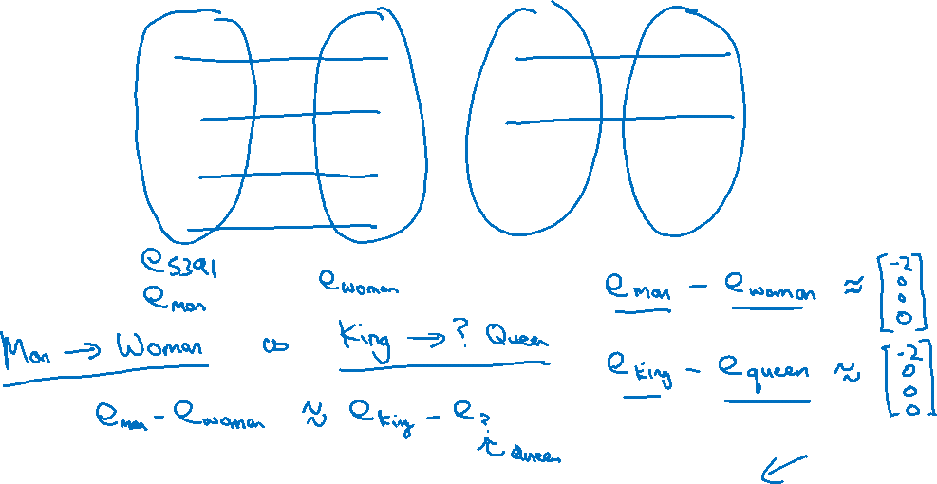




Analogies
Man
(5391)
Woman
(9853)
King
(4914)
Queen
(7157)
Apple
(456)
Orange
(6257)
Gender
$$−1$$
1
-0.95
$$0.97$$
0.00
0.01
Royal
$$0.01$$
0.02
0.93
$$0.95$$
-0.01
0.00
Age
0.03
0.02
0.70
0.69
0.03
-0.02
Food
0.09
0.01
0.02
0.01
0.95
0.97
[Mikolov et. al., 2013, Linguistic regularities in continuous space word representations]

Slide 3
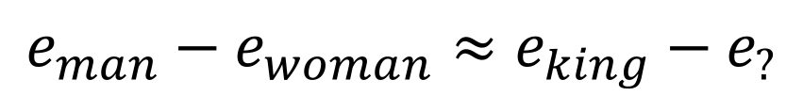
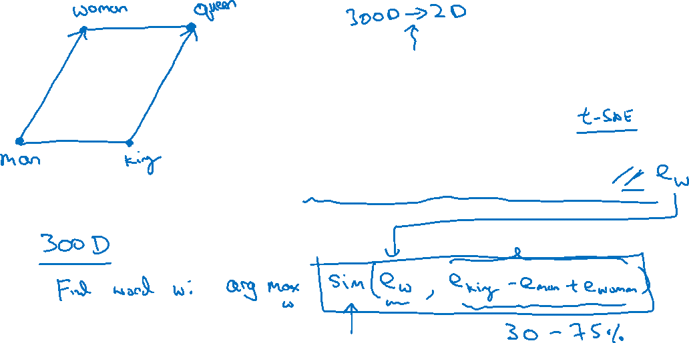
Analogies using word vectors
man
woman
dog
king
cat
queen
fish
three
four
apple
grape
one
two
orange
$$e_{man}−e_{woman}≈e_{king}−e_{?}$$

Slide 4
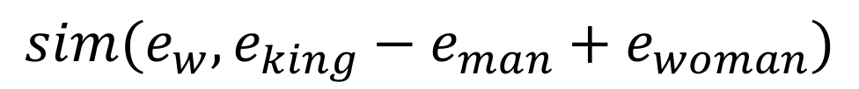
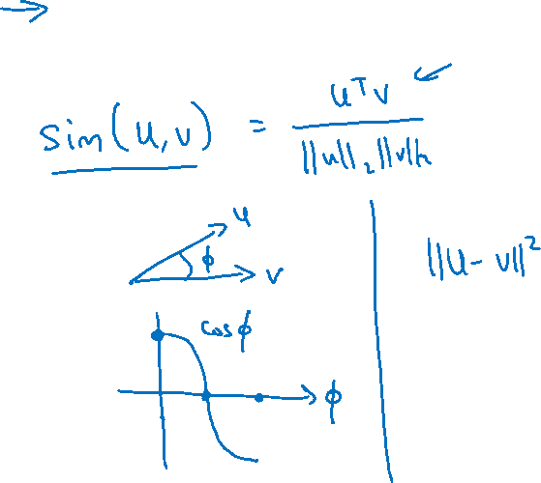
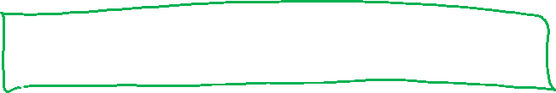
Cosine similarity
$$sim(e_{w}, e_{king}−e_{man}+e_{woman})$$
Man:Woman as Boy:Girl
Ottawa:Canada as Nairobi:Kenya
Big:Bigger as Tall:Taller
Yen:Japan as Ruble:Russia

